Slide 1
Identity Management
Sprint 3
Jacob Gianakopoulos, Steven Scott, Samuel Vitale, Alex Bowen, Andy Jolagh, Nick Attisha

Slide 2
Sprint 3 Plan
Our plan for this sprint was to wrap up app logins (including profile edits and password changes) and finish up lingering tasks from the following sprint. We also wanted to start configuring our server and breaking down facial recognition.
Jacob - Android app code, server code
Nick - Facial Recognition backend
Alex - UI design, research for camera features.
Steven - Server configuration, login features
Samuel - Database design and documentation
Andy- UI design frontend

Slide 3
Risk and Challenges
Distanced Communication and work
Dealing with conflicting work schedules/ availability
We are working with sensitive information, and therefore must value security very highly when creating this product
Miscommunication
Personal Life Problems

Slide 4
Server
Decided to use Google Cloud Platform using leftover education credits
Our server is cheap enough to run it for approx 8 months without paying
Installed Ubuntu, mysql, and apache
Created db by running our sprint 2 scripts
Set up user accounts and db accounts for each member

Slide 5
Database
Database storage of biometric data will be too large
Using file paths leading to the files which will be stored on the server.
Fine tuning of tables and proper implementation of keys

Slide 6
Backend Progress
Fixed all lingering issues with logins
Added more fields for user registration
A profile update task that allows users to update the information they used to register
A password change task that allows users to change their password
Storing of user information for later use
Added more in-app checks before contacting server
Server code to accomplish these tasks

Slide 7
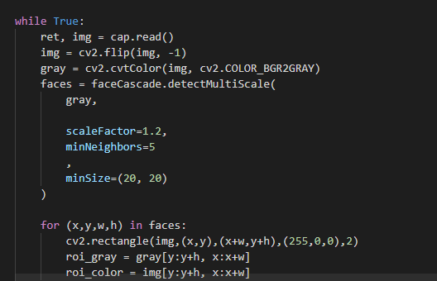
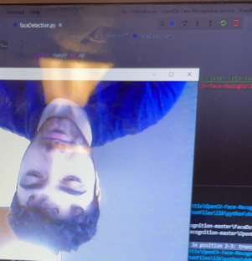
Facial Recognition Progress
-Facial Detection is a work in progress. Working out various bugs to make sure everything is smooth before moving on to the recognition aspect.

Slide 8
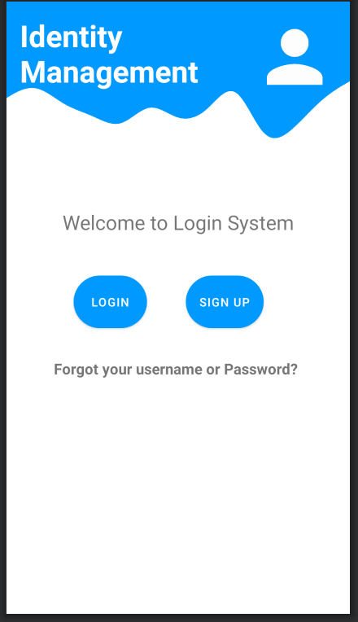
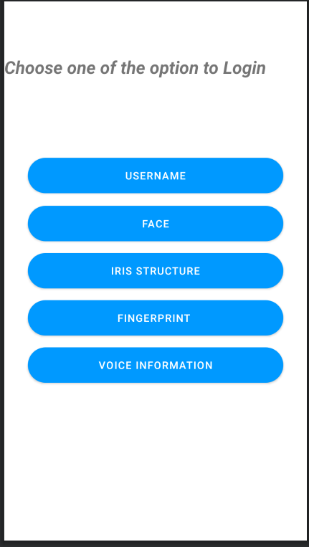
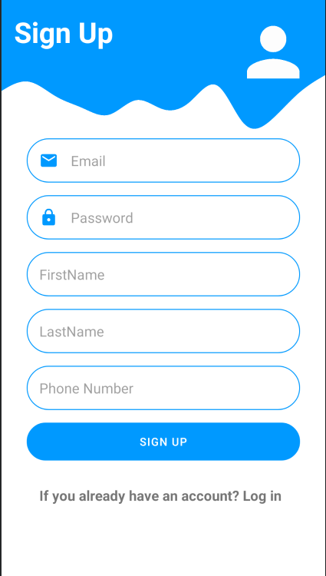
Conceptual UI Design

Slide 9
Sprint Schedule
Project Details and Requirements
User Account Creation (Jan 21st - 25th)
Finish back end code for a safer logins and finalize the main pages for the Application. We would also like to start breaking down tasks for and working on Face recognition (Jan 26th - Feb 8th)
Focus on creating Face scanning feature in app. Improve design and functionality of the Application for android. (Feb 8th - 17th)
Focus on fine tuning the face scanning features of the app. If work on the Face scanning finishes earlier than expected then begin working on next feature for the app (Feb 17th - March 1st)
Try to get started on a finger scanning features for the app. Focusing on the API and UI with the new features. (March 1st - 14th)

Slide 10
Sprint 4 Preview: App wrap up and facial recognition
Our approach for this sprint is to form groups of 2 and work together on the necessary tasks. We split the responsibilities as follows:
Database and Server - Steven and Samuel
Since the server is setup, not much more is required. Tweak database and server settings as needed.
Work on backend tasks. Improve overall login experience.
Front-End design - Alex and Andy
Work on improving the UI and adding a new screen for Camera features as well as more features in the future.
Backend - Jacob and Nick
Adding camera access for facial recognition and saving uploaded files on the server
Continue implementing facial recognition

Slide 11
Future User Stories
As a user, i want to update my account. Includes changing your password and editing basic data.
As a user, I want to be able to upload face data. Includes creating the front end for managing pictures, connecting to their camera to capture images, and saving it onto the server.
As a user, I want to be able to login via facial recognition
Includes Implementing the facial recognition package, updating the login page to show the new login option, and writing the backend code to log the user in when the face matches what is stored.

Slide 12
Demo

